Slide 1

Chapter 1
Computer Network and the Internet
A note on the use of these PowerPoint slides:
We’re making these slides freely available to all (faculty, students, readers). They’re in PowerPoint form so you see the animations; and can add, modify, and delete slides (including this one) and slide content to suit your needs. They obviously represent a lot of work on our part. In return for use, we only ask the following:
If you use these slides (e.g., in a class) that you mention their source (after all, we’d like people to use our book!)
If you post any slides on a www site, that you note that they are adapted from (or perhaps identical to) our slides, and note our copyright of this material.
For a revision history, see the slide note for this page.
Thanks and enjoy! JFK/KWR
All material copyright 1996-2020
J.F Kurose and K.W. Ross, All Rights Reserved
Computer Networking: A Top-Down Approach
8th edition
Jim Kurose, Keith Ross
Pearson, 2020
Notes:
Version History
7.2 (January 2020)
All slides reformatted for 16:9 aspect ratio
Use of Calibri font, rather that Gill Sans MT
Updated slide content for 2020 link technologies and applications
Add more animation throughout
New Master slide
Feb. 2020
a few updates suggest by Catherine Rosenberg (thanks!)
titles in a lighter font

Slide 2

Chapter 1: introduction
Chapter goal:
Get “feel,” “big picture,” introduction to terminology
  more depth, detail later in course
Approach:
  use Internet as example
Overview/roadmap:
What is the Internet?
What is a protocol?
Network edge: hosts, access network, physical media
Network core: packet/circuit switching, internet structure
Performance: loss, delay, throughput
Security
Protocol layers, service models
History

Slide 3

What Is the Internet?
Internet can be defined in two ways
  The basic components – i.e. the nuts and bolt view
    the basic hardware and software components that make up the Internet
  The services it provide – service view
    a networking infrastructure that provides services to distributed applications
Internet: the network of networks

Slide 4
















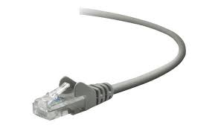
The Internet: a “nuts and bolts” view
Billions of connected computing devices:
  hosts = end systems
  running network apps at Internet’s “edge”
mobile network
national or global ISP
Packet switches: forward packets (chunks of data)
  routers, switches
local or regional ISP
Internet
Communication links
  fiber, copper, radio, satellite
  transmission rate: bandwidth
home network
content
provider
network
datacenter
network
Networks
  collection of devices, routers, links: managed by an organization
enterprise
network

Slide 5
The Internet: a “nuts and bolts” view
Internet: “network of networks”
  Interconnected ISPs
mobile network
4G
national or global ISP
protocols are everywhere
  control sending, receiving of messages
  e.g., HTTP (Web), streaming video, Skype, TCP, IP, WiFi, 4G, Ethernet
IP
Streaming
video
Skype
local or regional ISP
Internet standards
  RFC: Request for Comments
  IETF: Internet Engineering Task Force
home network
content
provider
network
HTTP
datacenter
network
Ethernet
All the pieces of the Internet run protocols that controls the sending and receiving of information
TCP/IP are two of the most important protocols in the Internet
TCP
enterprise
network
WiFi

Slide 6
The Internet: a “service” view
Infrastructure that provides services to applications:
  Web, streaming video, multimedia teleconferencing, email, games, e-commerce, social media, inter-connected appliances, …
mobile network
national or global ISP
Streaming
video
Skype
local or regional ISP
provides programming interface to distributed applications:
  “hooks” allowing sending/receiving apps to “connect” to, use Internet transport service
  provides service options, analogous to postal service
home network
content
provider
network
HTTP
datacenter
network
enterprise
network

Slide 7

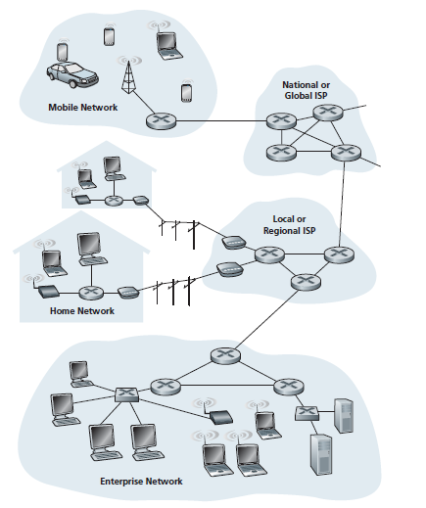
The ‘service’ view
These applications include
  email, Web surfing, social networks, instant messaging, Voiceover-IP (VoIP), video streaming, distributed games, peer-to-peer (P2P) file sharing, etc
  Distributed applications 🡺 involve multiple end systems exchanging data
Have Application Programming Interface (API)
  to communicate between different platforms through the Internet
Internet is a network of networks
  Interconnected ISPs
Introduction: 1-‹#›
Notes:
These applications include email, Web surfing, social networks, instant messaging, Voiceover-IP (VoIP), video streaming, distributed games, peer-to-peer (P2P) file sharing, television over the Internet, remote login, and much, much more.
The applications are said to be distributed applications, since they involve multiple end systems that exchange data with each other

Slide 8


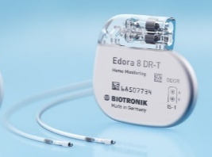





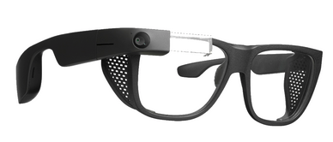


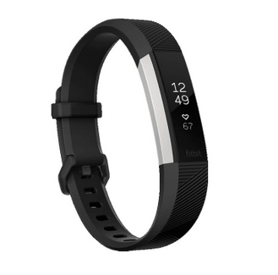

“Fun” Internet-connected devices
Pacemaker & Monitor
Tweet-a-watt:
monitor energy use
Amazon Echo
IP picture frame
Web-enabled toaster +
weather forecaster
Internet
refrigerator
Slingbox: remote
control cable TV
Security Camera
AR devices
sensorized,
bed
mattress
Others?
Internet phones
Fitbit

Slide 9
What’s a protocol?
Human protocols:
“what’s the time?”
“I have a question”
introductions
… specific messages sent
… specific actions taken when message received, or other events
Network protocols:
computers (devices) rather than humans
all communication activity in Internet governed by protocols
Protocols define the format, order of messages sent and received among network entities, and actions taken on msg transmission, receipt

Slide 10



What’s a protocol?
A human protocol and a computer network protocol:
Hi
TCP connection
request
Hi
TCP connection
response
Got the
time?
GET http://gaia.cs.umass.edu/kurose_ross
2:00
<file>
time
Q: other human protocols?
Notes:
Explain important points
distributed entities, exchanging messages (governed by protocols)
Time going down
go over definition of protocol (showing format, order of messages sent and received, and actions taken)
We’ll see these kinds of diagrams a lot

Slide 11
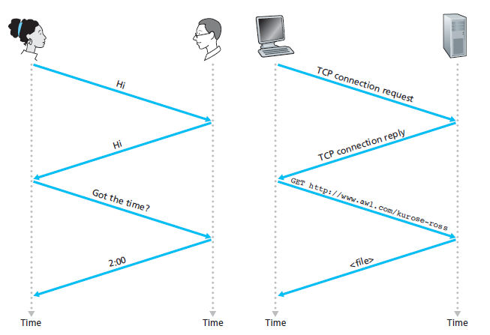
A human protocol
A computer network protocol
Introduction: 1-‹#›
Notes:
Introductions
specific message sent
🡪specific actions taken when message received, or other events

Slide 12
Chapter 1: roadmap
What is the Internet?
What is a protocol?
Network edge: hosts, access network, physical media
Network core: packet/circuit switching, internet structure
Performance: loss, delay, throughput
Security
Protocol layers, service models
History

Slide 13
A closer look at Internet structure
mobile network
Network edge:
hosts: clients and servers
servers often in data centers
national or global ISP
local or regional ISP
home network
content
provider
network
datacenter
network
enterprise
network

Slide 14
A closer look at Internet structure
mobile network
Network edge:
hosts: clients and servers
servers often in data centers
Access networks, physical media:
wired, wireless communication links
national or global ISP
local or regional ISP
home network
content
provider
network
datacenter
network
enterprise
network

Slide 15
A closer look at Internet structure
mobile network
Network edge:
hosts: clients and servers
servers often in data centers
Access networks, physical media:
wired, wireless communication links
Network core:
  interconnected routers
  network of networks
national or global ISP
local or regional ISP
home network
content
provider
network
datacenter
network
enterprise
network

Slide 16
A closer look
Media: Wired/wireless
Network edge
Access Networks
Network Core

Slide 17
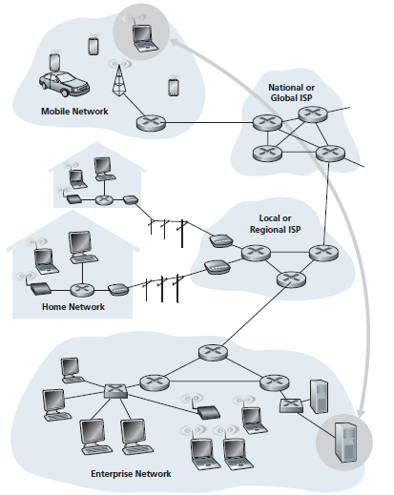
End system interaction

Slide 18
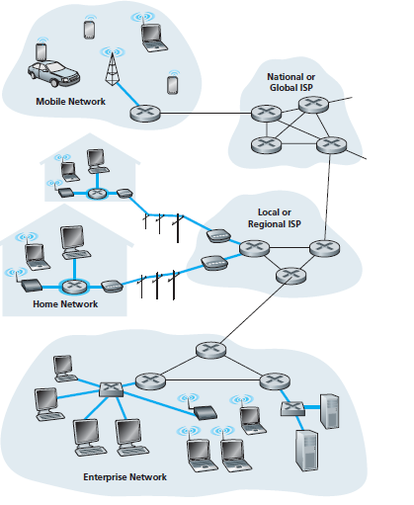
Access networks
The network that physically connects an end system to the first router (also known as the “edge router”) on a path from the end system to any other distant end system.

Slide 19
Access networks and physical media
Q: How to connect end systems to edge router?
residential access nets
institutional access networks (school, company)
mobile access networks (WiFi, 4G/5G)
mobile network
national or global ISP
local or regional ISP
What to look for:
transmission rate (bits per second) of access network?
shared or dedicated access among users?
home network
content
provider
network
datacenter
network
enterprise
network

Slide 20

Access networks: digital subscriber line (DSL)
central office
telephone
network
DSL
modem
splitter
DSLAM
voice, data transmitted
at different frequencies over
dedicated line to central office
ISP
DSL access
multiplexer
  use existing telephone line to central office DSLAM
    data over DSL phone line goes to Internet
    voice over DSL phone line goes to telephone net
  24-52 Mbps dedicated downstream transmission rate
  3.5-16 Mbps dedicated upstream transmission rate

Slide 21
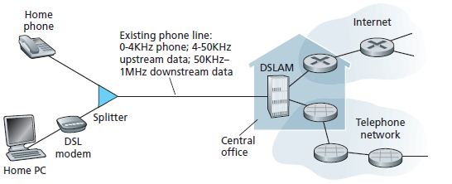

Slide 22



Access networks: cable-based access
cable headend
…
cable
modem
splitter
CMTS
cable modem
termination system
data, TV transmitted at different
frequencies over shared cable
distribution network
ISP
HFC: hybrid fiber coax
  asymmetric: up to 40 Mbps – 1.2 Gbs downstream transmission rate, 30-100 Mbps upstream transmission rate
network of cable, fiber attaches homes to ISP router
  homes share access network to cable headend
  unlike DSL, which has dedicated access to central office

Slide 23
Access networks: cable-based access
cable headend
…
cable
modem
splitter
C
O
N
T
R
O
L
V
I
D
E
O
V
I
D
E
O
V
I
D
E
O
V
I
D
E
O
V
I
D
E
O
V
I
D
E
O
D
A
T
A
D
A
T
A
1
2
3
4
5
6
7
8
9
Channels
frequency division multiplexing (FDM): different channels transmitted in different frequency bands

Slide 24
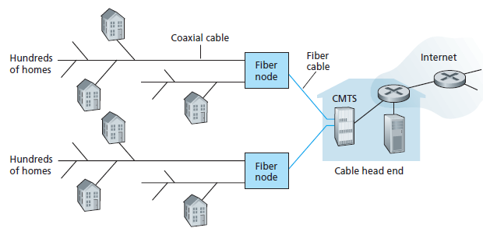
C
O
N
T
R
O
L
V
I
D
E
O
V
I
D
E
O
V
I
D
E
O
V
I
D
E
O
V
I
D
E
O
V
I
D
E
O
D
A
T
A
D
A
T
A
1
2
3
4
5
6
7
8
9
Channels

Slide 25







Access networks: home networks
wireless
devices
to/from headend or central office
often combined
in single box
cable or DSL modem
WiFi wireless access
point (54, 450 Mbps)
router, firewall, NAT
wired Ethernet (1 Gbps)

Slide 26









Access networks: enterprise networks
Enterprise link to
ISP (Internet)
institutional router
Ethernet
switch
institutional mail,
web servers
companies, universities, etc.
  mix of wired, wireless link technologies, connecting a mix of switches and routers (we’ll cover differences shortly)
    Ethernet: wired access at 100Mbps, 1Gbps, 10Gbps
    WiFi: wireless access points at 11, 54, 450 Mbps

Slide 27
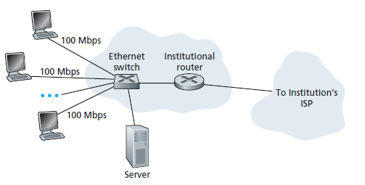

Slide 28








Wireless access networks
Shared wireless access network connects end system to router
via base station aka “access point”
Wide-area cellular access networks
  provided by mobile, cellular network operator (10’s km)
  10’s Mbps
  4G cellular networks (5G coming)
Wireless local area networks (WLANs)
  typically within or around building (~100 ft)
  802.11b/g/n (WiFi): 11, 54, 450 Mbps transmission rate
to Internet
to Internet

Slide 29


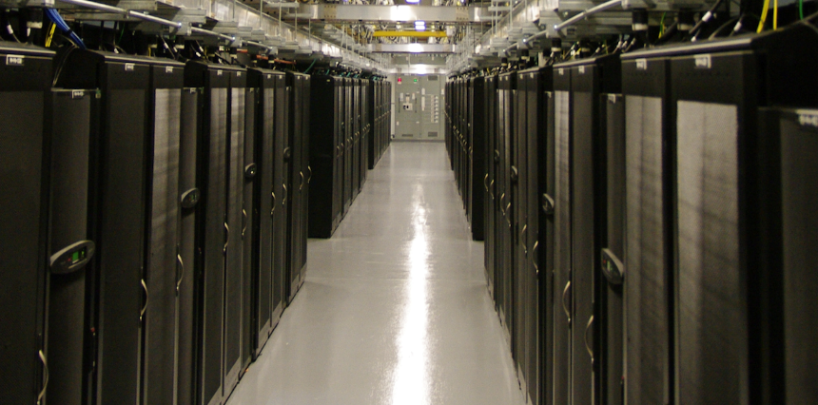





Access networks: data center networks
high-bandwidth links (10s to 100s Gbps) connect hundreds to thousands of servers together, and to Internet
mobile network
national or global ISP
local or regional ISP
home network
content
provider
network
datacenter
network
Courtesy: Massachusetts Green High Performance Computing Center (mghpcc.org)
enterprise
network
Introduction: 1-‹#›

Slide 30


Host: sends packets of data
host sending function:
takes application message
breaks into smaller chunks, known as packets, of length L bits
transmits packet into access network at transmission rate R
  link transmission rate, aka link capacity, aka link bandwidth
two packets,
L bits each
2
1
host
R: link transmission rate
packet
transmission
delay
time needed to
transmit L-bit
packet into link
L (bits)
R (bits/sec)
=
=

Slide 31

Host: sends packets of data
packet
transmission
delay
time needed to
transmit L-bit
packet into link
two packets,
L bits each
=
L (bits)
R (bits/sec)
2
1
=
R: link transmission rate
host
Example: L=30Mbit, R=10Mbps
packet transmission delay
= L/R
= 30Mbit/10Mbps
= 3s

Slide 32
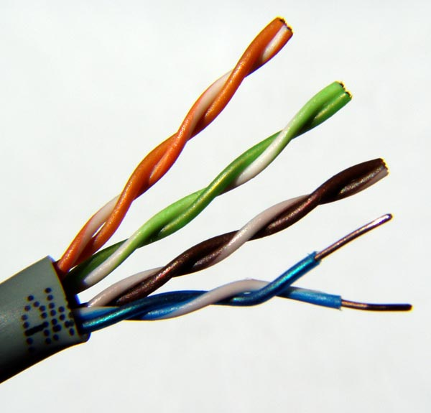
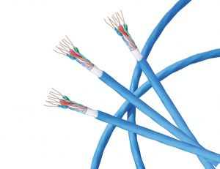
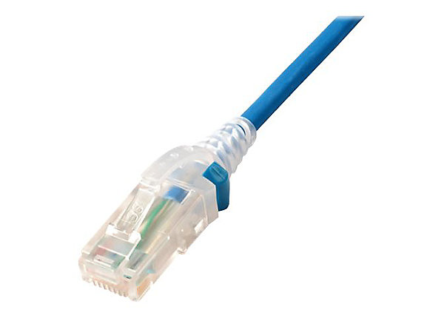
Links: physical media
bit: propagates between
transmitter/receiver pairs
physical link: what lies between transmitter & receiver
guided media:
  signals propagate in solid media: copper, fiber, coax
unguided media:
  signals propagate freely, e.g., radio
Twisted pair (TP)
two insulated copper wires
  Category 5: 100 Mbps, 1 Gbps Ethernet
  Category 6: 10Gbps Ethernet

Slide 33
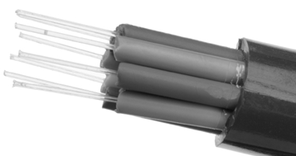

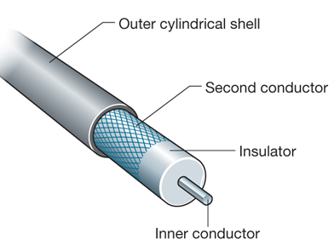


Links: physical media
Coaxial cable:
two concentric copper conductors
bidirectional
broadband:
  multiple frequency channels on cable
  100’s Mbps per channel
Fiber optic cable:
glass fiber carrying light pulses, each pulse a bit
high-speed operation:
  high-speed point-to-point transmission (10’s-100’s Gbps)
low error rate:
  repeaters spaced far apart
  immune to electromagnetic noise

Slide 34
Links: physical media
Wireless radio
signal carried in electromagnetic spectrum
no physical “wire”
broadcast and “half-duplex” (sender to receiver)
propagation environment effects:
  reflection
  obstruction by objects
  interference
Radio link types:
terrestrial microwave
  up to 45 Mbps channels
Wireless LAN (WiFi)
  Up to 100’s Mbps
wide-area (e.g., cellular)
  4G cellular: ~ 10’s Mbps
satellite
  up to 45 Mbps per channel
  270 msec end-end delay
  geosynchronous versus low-earth-orbit

Slide 35
Chapter 1: roadmap
What is the Internet?
What is a protocol?
Network edge: hosts, access network, physical media
Network core: packet/circuit switching, internet structure
Performance: loss, delay, throughput
Security
Protocol layers, service models
History

Slide 36
The network core
mesh of interconnected routers
packet-switching: hosts break application-layer messages into packets
  forward packets from one router to the next, across links on path from source to destination
  each packet transmitted at full link capacity
mobile network
national or global ISP
local or regional ISP
home network
content
provider
network
datacenter
network
enterprise
network

Slide 37



Packet-switching: store-and-forward
L bits
per packet
source
3
2
1
destination
R bps
R bps
Transmission delay: takes L/R seconds to transmit (push out) L-bit packet into link at R bps
Store and forward: entire packet must arrive at router before it can be transmitted on next link
End-end delay: 2L/R (above), assuming zero propagation delay (more on delay shortly)
One-hop numerical example:
L = 10 Kbits
R = 100 Mbps
one-hop transmission delay = 0.1 msec

Slide 38
one-hop numerical example:
L = 7.5 Mbits
R = 1.5 Mbps
one-hop transmission delay = L/R = 5 sec
One-hop numerical example:
L = 10 Kbits
R = 100 Mbps
one-hop transmission delay = 0.1 msec
Introduction: 1-‹#›

Slide 39
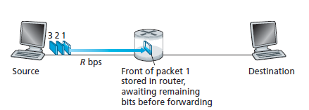
transmitting some of packet 1
the source has three packets, each consisting of L bits, to send to the destination.
When the router has received
all of the packet’s bits can it begin to transmit the packet onto the outbound link.
The router employs store-and-forwarding 🡺 so must first buffer (“store”) the packet’s bits
Introduction: 1-‹#›
Notes:
Transmit = forward

Slide 40

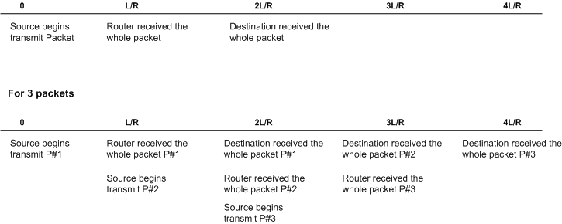
If not store-n-forward:
end-end delay = L/R (assuming no propagation delay)
Router
Time
end-end delay = 2L/R (assuming no propagation delay)
end-end delay = N(L/R)
where
N = the number of links between source and destination
Introduction: 1-‹#›

Slide 41
Packet-switching: queueing delay, loss
R = 100 Mb/s
C
A
R = 1.5 Mb/s
D
B
E
queue of packets
waiting for output link
Packet queuing and loss: if arrival rate (in bps) to link exceeds transmission rate (bps) of link for a period of time:
packets will queue, waiting to be transmitted on output link
packets can be dropped (lost) if memory (buffer) in router fills up

Slide 42
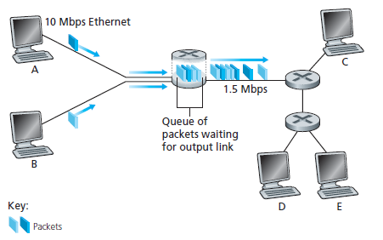
Packet Switching: Queuing Delays and Packet Loss
output buffer /output queue
A and B sends packets to the router
The router forwards packet to destination
When packets arrival at the router exceeds 1.5 Mbps, congestion will occur at the router as packets queue
When packets arrives and queue is full, packet will be dropped 🡺 resulting in packet loss.
Introduction: 1-‹#›

Slide 43
Two key network-core functions
routing algorithm
Routing:
global action: determine source-destination paths taken by packets
routing algorithms
routing algorithm
Forwarding:
local action: move arriving packets from router’s input link to appropriate router output link
local forwarding table
local forwarding table
header value
output link
0100
0101
0111
1001
3
2
2
1
1
3
2
0111
destination address in arriving
packet’s header

Slide 44
Two key network-core functions
ROUTING
FORWARDING
determines source to destination route taken by packets
  routing algorithms
Global action
move packets from router input interface to appropriate router output interface
Local Action
Introduction: 1-‹#›

Slide 45
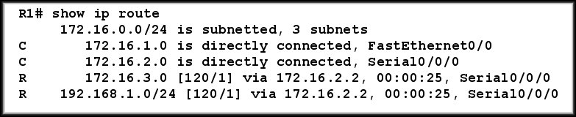
1
3
R1 finds the best path to destination
Router R1 receives a packet
R1 checks the destination address
R1 forwards the packet (or drops it)
2
4
Packet destination: 192.168.1.1
Introduction: 1-‹#›

Slide 46
Alternative to packet switching: circuit switching
end-end resources allocated to, reserved for “call” between source and destination
in diagram, each link has four circuits.
  call gets 2nd circuit in top link and 1st circuit in right link.
dedicated resources: no sharing
  circuit-like (guaranteed) performance
circuit segment idle if not used by call (no sharing)
commonly used in traditional telephone networks

Slide 47
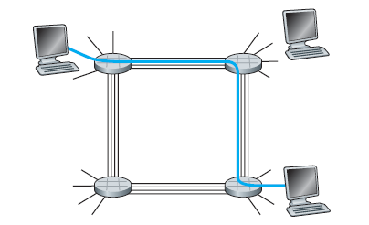
The 4 circuit switches are interconnected by 4 links.
Each of these links has four circuits 🡺 can support 4 simultaneous connections.
Each circuit ¼ of the link’s total transmission capacity for the duration of the connection.
Example:
If a link has a transmission rate of 1 Mbps
🡺 Each connection gets 250 kbps of dedicated transmission rate.
Introduction: 1-‹#›

Slide 48
Circuit switching: FDM and TDM
Users will access media (e.g. cable) based on DIFFERENT frequency (Hz) allocation
Frequency Division Multiplexing (FDM)
optical, electromagnetic frequencies divided into (narrow) frequency bands
each call allocated its own band, can transmit at max rate of that narrow band
4 users
frequency
time
Time Division Multiplexing (TDM)
time divided into slots
each call allocated periodic slot(s), can transmit at maximum rate of (wider) frequency band, but only during its time slot(s)
frequency
time
Users will access media (e.g. cable) based on DIFFERENT time slot (second) allocation

Slide 49
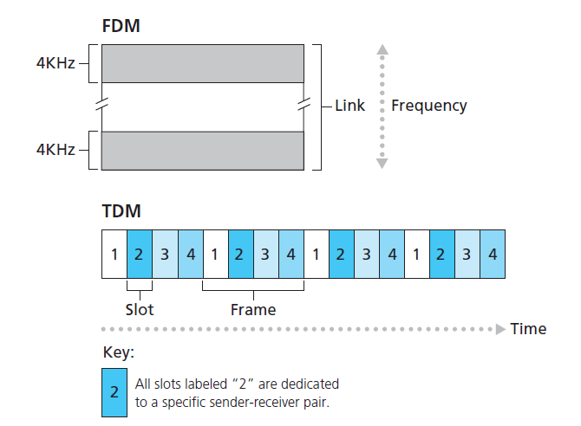
With FDM, each circuit continuously gets a fraction of the bandwidth.
With TDM, each circuit gets all of the bandwidth
periodically during brief intervals of time (that is, during slots)
Introduction: 1-‹#›

Slide 50
Packet switching versus circuit switching
packet switching allows more users to use network!
Example:
1 Gb/s link
each user:
  100 Mb/s when “active”
  active 10% of time
…..
N
users
1 Gbps link
circuit-switching: 10 users
packet switching: with 35 users, probability > 10 active at same time is less than .0004 *
Q: how did we get value 0.0004?
Q: what happens if > 35 users ?
* Check out the online interactive exercises for more examples: http://gaia.cs.umass.edu/kurose_ross/interactive

Slide 51
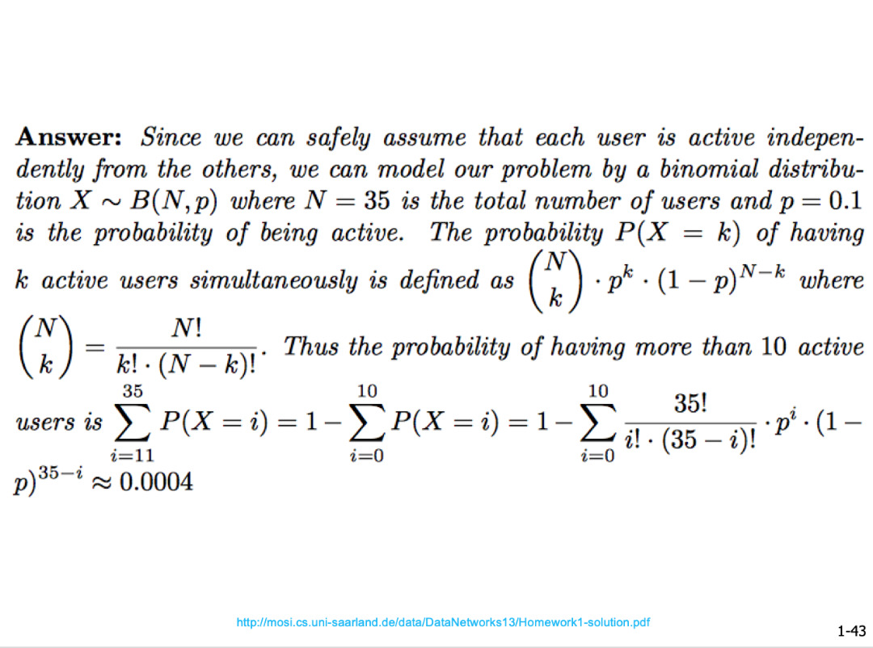
Not part of your syllabus – just extra knowledge
Introduction: 1-‹#›

Slide 52
Packet switching versus circuit switching
Is packet switching a “slam dunk winner”?
great for “bursty” data – sometimes has data to send, but at other times not
  resource sharing
  simpler, no call setup
excessive congestion possible: packet delay and loss due to buffer overflow
  protocols needed for reliable data transfer, congestion control
Q: How to provide circuit-like behavior?
  bandwidth guarantees traditionally used for audio/video applications
Q: human analogies of reserved resources (circuit switching) versus on-demand allocation (packet switching)?

Slide 53
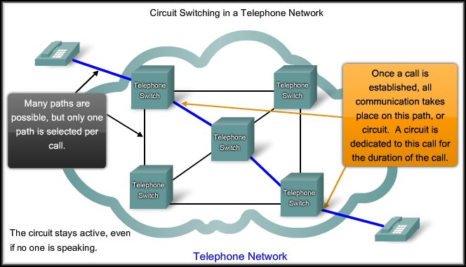
Circuit Switched – Connection-Oriented Networks
Introduction: 1-‹#›

Slide 54
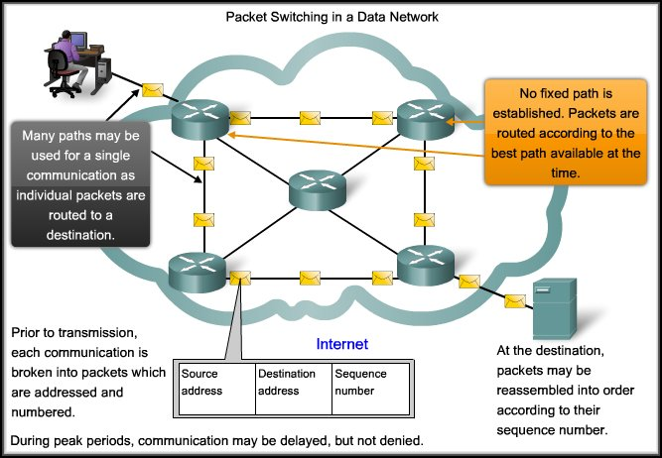
Packet Switched – Connectionless Networks
Introduction: 1-‹#›

Slide 55
Circuit Switched | Packet Switched
Connection-oriented | Connectionless
Dedicated Circuit | Shared Circuit
Guaranteed level of service (Bandwidth, QoS) | Messages divided into packets
Inefficient use of Medium | Efficient use of Medium
Single path, no redundancy | Fault Tolerant, multiple possible paths
Introduction: 1-‹#›

Slide 56
Internet structure: a “network of networks”
Hosts connect to Internet via access Internet Service Providers (ISPs)
    residential, enterprise (company, university, commercial) ISPs
Access ISPs in turn must be interconnected
    so that any two hosts can send packets to each other
Resulting network of networks is very complex
    evolution was driven by economics and national policies
Let’s take a stepwise approach to describe current Internet structure

Slide 57
Internet structure: a “network of networks”
Question: given millions of access ISPs, how to connect them together?
…
…
access
net
access
net
access
net
access
net
access
net
access
net
access
net
…
…
access
net
access
net
access
net
access
net
access
net
access
net
…
access
net
access
net
…
access
net

Slide 58
Internet structure: a “network of networks”
Question: given millions of access ISPs, how to connect them together?
…
…
access
net
access
net
access
net
access
net
access
net
…
…
access
net
access
net
connecting each access ISP to each other directly doesn’t scale: O(N²) connections.
…
…
…
access
net
access
net
…
access
net
access
net
access
net
…
access
net
…
access
net
access
net
…
access
net

Slide 59
Internet structure: a “network of networks”
Option: connect each access ISP to one global transit ISP?
Customer and provider ISPs have economic agreement.
…
…
access
net
access
net
access
net
access
net
access
net
access
net
access
net
…
…
global
ISP
access
net
access
net
access
net
access
net
access
net
access
net
…
access
net
access
net
…
access
net

Slide 60
Internet structure: a “network of networks”
But if one global ISP is viable business, there will be competitors ….
…
…
access
net
access
net
access
net
access
net
access
net
access
net
ISP A
access
net
…
…
access
net
ISP B
access
net
ISP C
access
net
access
net
access
net
access
net
…
access
net
access
net
…
access
net

Slide 61
Internet structure: a “network of networks”
But if one global ISP is viable business, there will be competitors …. who will want to be connected
Internet exchange point
…
…
access
net
access
net
access
net
access
net
access
net
IXP
access
net
access
net
ISP A
…
…
access
net
IXP
ISP B
access
net
ISP C
access
net
access
net
peering link
access
net
access
net
…
access
net
access
net
…
access
net

Slide 62
Internet structure: a “network of networks”
… and regional networks may arise to connect access nets to ISPs
…
…
access
net
access
net
access
net
access
net
access
net
IXP
access
net
access
net
ISP A
…
…
access
net
IXP
ISP B
access
net
ISP C
access
net
access
net
access
net
regional ISP
access
net
…
access
net
access
net
…
access
net

Slide 63
Internet structure: a “network of networks”
… and content provider networks (e.g., Google, Microsoft, Akamai) may run their own network, to bring services, content close to end users
…
…
access
net
access
net
access
net
access
net
access
net
IXP
access
net
access
net
ISP A
…
…
Content provider network
access
net
IXP
ISP B
access
net
ISP C
access
net
access
net
access
net
regional ISP
access
net
…
access
net
access
net
…
access
net

Slide 64
Internet structure: a “network of networks”
Tier 1 ISP
Tier 1 ISP
Google
IXP
IXP
IXP
Regional ISP
Regional ISP
access
ISP
access
ISP
access
ISP
access
ISP
access
ISP
access
ISP
access
ISP
access
ISP
At “center”: small # of well-connected large networks
  “tier-1” commercial ISPs (e.g., Level 3, Sprint, AT&T, NTT), national & international coverage
  content provider networks (e.g., Google, Facebook): private network that connects its data centers to Internet, often bypassing tier-1, regional ISPs
  Example ISP list in Malaysia: List , Service Offer , Service Cost

Slide 65
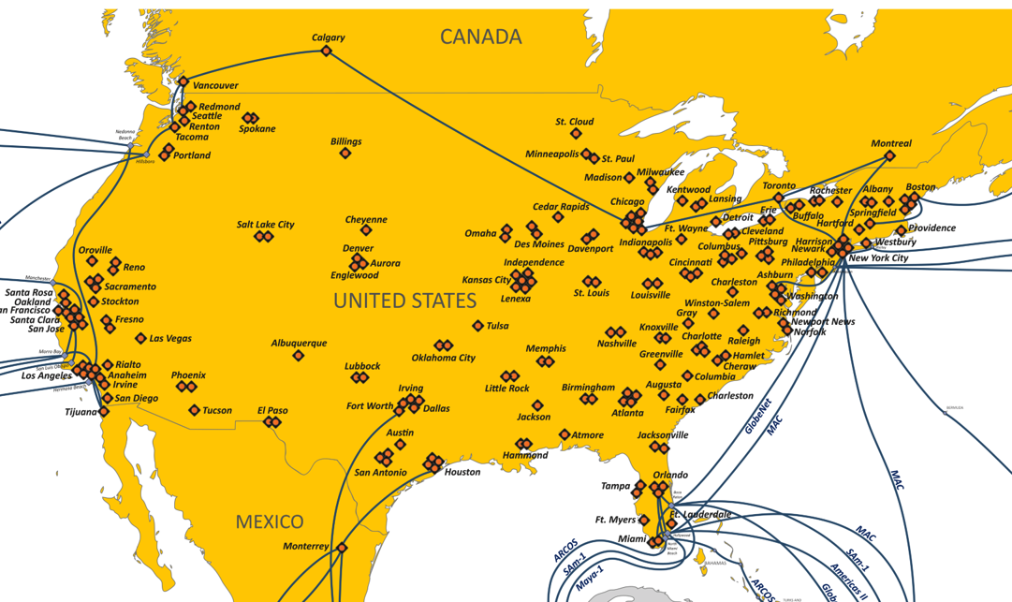
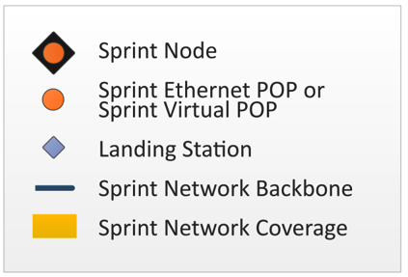
Tier-1 ISP Network map: Sprint (2019)
POP: point-of-presence
to/from other Sprint PoPS
links to peering networks
…
…
…
…
…
links to/from Sprint customer networks

Slide 66
Chapter 1: roadmap
What is the Internet?
What is a protocol?
Network edge: hosts, access network, physical media
Network core: packet/circuit switching, internet structure
Performance: loss, delay, throughput
Security
Protocol layers, service models
History

Slide 67
How do packet loss and delay occur?
packets queue in router buffers
packets queue, wait for turn
arrival rate to link (temporarily) exceeds output link capacity: packet loss
packet being transmitted (transmission delay)
A
B
packets in buffers (queueing delay)
free (available) buffers: arriving packets
dropped (loss) if no free buffers

Slide 68
How do loss and delay occur?
packets queuing (delay)
packet being transmitted (delay)
Queue is full, packet dropped (loss)

Slide 69
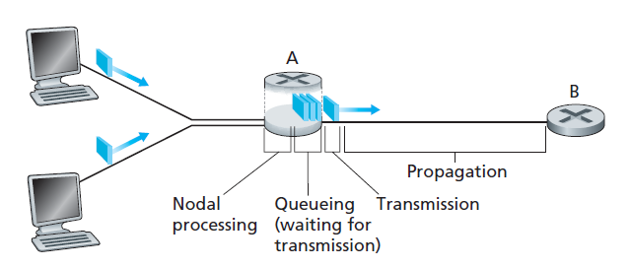
The nodal delay at router A
A packet goes through a series of delays at each node along the path
d_{prop}
d_{trans}
d_{proc}
d_{queue}
Total nodal delay = d_{nodal} = d_{proc} + d_{queue} + d_{trans} + d_{prop}
Introduction: 1-‹#›
Notes:
Total nodal delay = nodal processing delay + queuing delay + transmission Delay + propagation delay

Slide 70
Packet delay: four sources
transmission
A
propagation
B
nodal
processing
queueing
d_{nodal} = d_{proc} + d_{queue} + d_{trans} + d_{prop}
d_{proc}: nodal processing
check bit errors
determine output link
typically < msec
d_{queue}: queueing delay
time waiting at output link for transmission
depends on congestion level of router

Slide 71
Packet delay: four sources
transmission
A
propagation
B
nodal
processing
queueing
d_{nodal} = d_{proc} + d_{queue} + d_{trans} + d_{prop}
d_{trans}: transmission delay:
L: packet length (bits)
R: link transmission rate (bps)
d_{trans} = L/R
d_{prop}: propagation delay:
d: length of physical link
s: propagation speed (~2x10⁸ m/sec)
d_{prop} = d/s
d_{trans} and d_{prop}
very different
* Check out the online interactive exercises: http://gaia.cs.umass.edu/kurose_ross

Slide 72


Caravan analogy
100 km
100 km
ten-car caravan
(aka 10-bit packet)
toll booth
(aka router)
toll booth
cars “propagate” at 100 km/hr
toll booth takes 12 sec to service car (bit transmission time)
car ~ bit; caravan ~ packet
Q: How long until caravan is lined up before 2nd toll booth?
time to “push” entire caravan through toll booth onto highway = 12*10 = 120 sec
time for last car to propagate from 1st to 2nd toll both: 100km/(100km/hr) = 1 hr
A: 62 minutes

Slide 73
Caravan analogy
100 km
100 km
ten-car caravan
(aka 10-bit packet)
toll booth
(aka router)
toll booth
suppose cars now “propagate” at 1000 km/hr
and suppose toll booth now takes one min to service a car
Q: Will cars arrive to 2nd booth before all cars serviced at first booth?
A: Yes! after 7 min, first car arrives at second booth; three cars still at first booth

Slide 74


Packet queueing delay (revisited)
R: link bandwidth (bps)
L: packet length (bits)
a: average packet arrival rate
average queueing delay
traffic intensity = La/R
1
La/R ~ 0: avg. queueing delay small
La/R -> 1: avg. queueing delay large
La/R > 1: more “work” arriving is more than can be serviced - average delay infinite!
La/R ~ 0
La/R -> 1

Slide 75
“Real” Internet delays and routes
what do “real” Internet delay & loss look like?
traceroute/tracert program: provides delay measurement from source to router along end-end Internet path towards destination. For all i:
  sends three packets that will reach router i on path towards destination (with time-to-live field value of i)
  router i will return packets to sender
  sender measures time interval between transmission and reply
3 probes
3 probes
3 probes

Slide 76
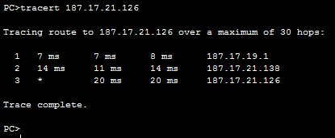
the destination system
The IP address of the hop
Hop number: The specific hop number in the path from the sender to the destination.
Round Trip Time (RTT):
The time it takes for a packet to get to a hop and back, displayed in milliseconds (ms).
🡺 By default, tracert sends 3 packets to each hop, so the output lists three roundtrip times per hop.
Introduction: 1-‹#›

Slide 77
Real Internet delays and routes
traceroute: gaia.cs.umass.edu to www.eurecom.fr
3 delay measurements from
gaia.cs.umass.edu to cs-gw.cs.umass.edu
1 cs-gw (128.119.240.254) 1 ms 1 ms 2 ms
2 border1-rt-fa5-1-0.gw.umass.edu (128.119.3.145) 1 ms 1 ms 2 ms
3 cht-vbns.gw.umass.edu (128.119.3.130) 6 ms 5 ms 5 ms
4 jn1-at1-0-0-19.wor.vbns.net (204.147.132.129) 16 ms 11 ms 13 ms
5 jn1-so7-0-0-0.wae.vbns.net (204.147.136.136) 21 ms 18 ms 18 ms
6 abilene-vbns.abilene.ucaid.edu (198.32.11.9) 22 ms 18 ms 22 ms
7 nycm-wash.abilene.ucaid.edu (198.32.8.46) 22 ms 22 ms 22 ms
8 62.40.103.253 (62.40.103.253) 104 ms 109 ms 106 ms
9 de2-1.de1.de.geant.net (62.40.96.129) 109 ms 102 ms 104 ms
10 de.fr1.fr.geant.net (62.40.96.50) 113 ms 121 ms 114 ms
11 renater-gw.fr1.fr.geant.net (62.40.103.54) 112 ms 114 ms 112 ms
12 nio-n2.cssi.renater.fr (193.51.206.13) 111 ms 114 ms 116 ms
13 nice.cssi.renater.fr (195.220.98.102) 123 ms 125 ms 124 ms
14 r3t2-nice.cssi.renater.fr (195.220.98.110) 126 ms 126 ms 124 ms
15 eurecom-valbonne.r3t2.ft.net (193.48.50.54) 135 ms 128 ms 133 ms
16 194.214.211.25 (194.214.211.25) 126 ms 128 ms 126 ms
17 * * *
18 * * *
19 fantasia.eurecom.fr (193.55.113.142) 132 ms 128 ms 136 ms
3 delay measurements
to border1-rt-fa5-1-0.gw.umass.edu
trans-oceanic link
looks like delays decrease! Why?
* means no response (probe lost, router not replying)
* Do some traceroutes from exotic countries at www.traceroute.org

Slide 78
Packet loss
queue (aka buffer) preceding link in buffer has finite capacity
packet arriving to full queue dropped (aka lost)
lost packet may be retransmitted by previous node, by source end system, or not at all
buffer
(waiting area)
A
packet being transmitted
B
packet arriving to
full buffer is lost
* Check out the Java applet for an interactive animation on queuing and loss

Slide 79
Throughput
throughput: rate (bits/time unit) at which bits are being sent from sender to receiver
  instantaneous: rate at given point in time
  average: rate over longer period of time
link capacity
R_{s} bits/sec
link capacity
R_{c} bits/sec
pipe that can carry
fluid at rate
(R_{s} bits/sec)
pipe that can carry
fluid at rate
(R_{c} bits/sec)
server sends bits
(fluid) into pipe
server, with
file of F bits
to send to client

Slide 80
Throughput
R_{s} < R_{c} What is average end-end throughput?
R_{s} bits/sec
R_{c} bits/sec
R_{s} > R_{c} What is average end-end throughput?
R_{s} bits/sec
R_{c} bits/sec
bottleneck link
link on end-end path that constrains end-end throughput

Slide 81
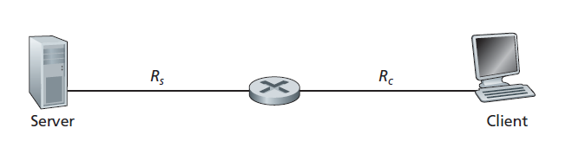
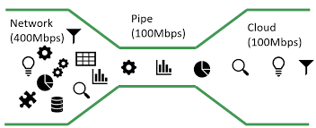
If R_{s} < R_{c}
  Flow from Server to Client not interrupted
  Throughput = R_{s}
If R_{s} > R_{c}
  Flow from Server to Client is interrupted, queue may form
  Throughput = R_{c}
Throughput = min{Rc, Rs},
🡺 the transmission rate of the bottleneck link
Introduction: 1-‹#›
Notes:
Tip:
In bottleneck link,
Throughput = the rate of the link on the end-to-end path that constrains end-to-end throughput 🡺 whichever is smaller

Slide 82
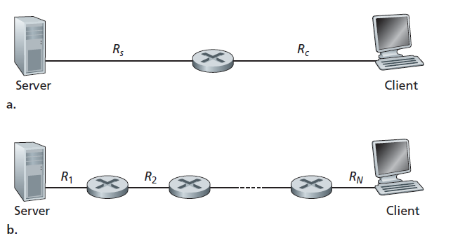
Throughput for a file transfer from server to client
Throughput = min{Rc, Rs},
Throughput = min{R1, R2,..., RN},
Introduction: 1-‹#›

Slide 83
Example A
The time it takes to transfer a large file of F bits from server to client as F/min{Rs, Rc}
Say, you are downloading a file of F = 32 million bits, the server has a transmission rate of Rs = 2 Mbps, and you have an access link of Rc = 1 Mbps.
The time needed to transfer the file is
Transfer time = (32 x 10⁶) bits/1Mbps
= 32 seconds
Notes:
Of course, these expressions for throughput and transfer time are
only approximations, as they do not account for store-and-forward and processing delays as well as protocol issues.

Slide 84
Throughput: network scenario
per-connection end-end throughput: min(R_{c},R_{s},R/10)
in practice: R_{c} or R_{s} is often bottleneck
R_{s}
R_{s}
R_{s}
R
R_{c}
R_{c}
R_{c}
* Check out the online interactive exercises for more examples: http://gaia.cs.umass.edu/kurose_ross/
10 connections (fairly) share backbone bottleneck link R bits/sec

Slide 85
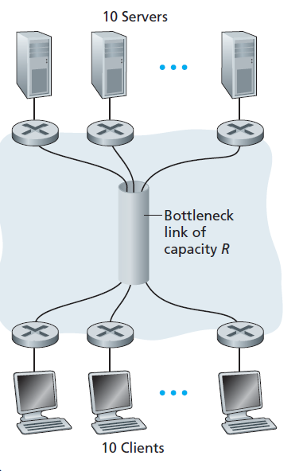
End-to-end throughput: Internet scenario
Example B:
If R_{s} = 2Mbps, R_{c} = 1Mbps, R = 5Mbps, what is the throughput?
Answer:
Because R is shared, what is available for each link is (5Mbps/10) = 500kbps
Throughput = 500kbps

Slide 86
Calculation: Example 1
Suppose Host A wants to send a large file to Host B. The path from Host A to Host B has 3-links, of rate R₁=150kbps, R₂=2Mbps, and R₃=1Mbps.
i) Assuming no other traffic in the network, what is the throughput for the file transfer? Justify your answer. [2 mark]
Throughput = min(R)=150 kbps
ii) Suppose the file is 4 million bytes. Roughly, how long will it take to transfer the file to Host B? [5 marks]
Time transfer=4*10⁶*8/(150*10³)=213.3 seconds

Slide 87
Calculation: Example 2
Host A wants to send a 30-Mbit MP3 file to host B. All the links in the path between source and destination have a transmission rate of 10Mbps. Assume that the propagation speed is 2*10⁸ meters/sec, and the distance between source and destination is 10km. Initially suppose there is only one link between the source and the destination. Also suppose that the entire MP3 file is sent as one packet (Ignore processing delay and queuing delay). Show your workings.
i) Calculate the transmission delay?
transmission delay = L/R = 30M/10Mbps = 3s
ii) What will be the end-to-end delay?
D_{prop} = d/s = 10000/2*10⁸ = 0.00005s
D_{total} = 3+0.00005 = 3. 00005s
iii) How many bits will the source have transmitted when the first bit of the MP3 file arrives at the destination?
R* D_{prop} = 10Mbps*0.00005s=500bit

Slide 88
Chapter 1: roadmap
What is the Internet?
What is a protocol?
Network edge: hosts, access network, physical media
Network core: packet/circuit switching, internet structure
Performance: loss, delay, throughput
Security
Protocol layers, service models
History

Slide 89
Protocol “layers” and reference models
Networks are complex,
with many “pieces”:
  hosts
  routers
  links of various media
  applications
  protocols
  hardware, software
Question:
is there any hope of organizing structure of network?
…. or at least our discussion of networks?

Slide 90

Example: organization of air travel
ticket (purchase)
baggage (check)
gates (load)
runway takeoff
airplane routing
ticket (complain)
baggage (claim)
gates (unload)
runway landing
airplane routing
airplane routing
airline travel: a series of steps, involving many services

Slide 91
Example: layering of organization of air travel
ticket (purchase)
baggage (check)
gates (load)
runway takeoff
airplane routing
ticketing service
ticket (complain)
baggage (claim)
gates (unload)
runway landing
airplane routing
baggage service
gate service
runway service
routing service
airplane routing
departure
airport
intermediate air-traffic
control centers
arrival
airport
layers: each layer implements a service
  via its own internal-layer actions
  relying on services provided by layer below

Slide 92
Why layering?
dealing with complex systems:
explicit structure allows identification, relationship of complex system’s pieces
  layered reference model for discussion
modularization eases maintenance, updating of system
  change in layer's service implementation: transparent to rest of system
  e.g., change in gate procedure doesn’t affect rest of system
layering considered harmful?
layering in other complex systems?

Slide 93
ISO/OSI reference model
Open System Interconnection (OSI) model defines a generic networking framework to implement protocols in seven (7) layers
Generic OSI Model
 | Data unit | Layer | Function
Host layers | Data | 7. Application | Network process to application
 |  | 6. Presentation | allow applications to interpret meaning of data, e.g. data representation, encryption and decryption, convert machine dependent data to machine independent data
 |  | 5. Session | Interhost communication, managing sessions between applications, synchronization, data recovery
 | Segments | 4. Transport | Reliable delivery of packets between points on a network.
Media layers | Packet/Datagram | 3. Network | Addressing, routing and (not necessarily reliable) delivery of datagrams between points on a network.
 | Bit/Frame | 2. Data link | A reliable direct point-to-point data connection.
 | Bit | 1. Physical | A (not necessarily reliable) direct point-to-point data connection.

Slide 94

OSI Model: AN Analogy: Application Layer - Source Host
After riding your new bicycle a few times in Tokyo, you decide that you want to give it to a friend who studies in UTM, JB.

Slide 95


Presentation & Session Layer - Source Host
PRESENTATION:
Make sure you have the proper directions to disassemble and reassemble the bicycle.
SESSION:
Call your friend and make sure you have his correct address.

Slide 96

OSI Model Analogy :Transport Layer - Source Host
Disassemble the bicycle and put different pieces in different boxes. The boxes are labeled
“1 of 3”, “2 of 3”, and “3 of 3”.

Slide 97

OSI Model Analogy: Network Layer - Source Host
Put your friend's complete mailing address (and yours) on each box. Since the packages are too big for your mailbox (and since you don’t have enough stamps) you determine that you need to go to the post office.

Slide 98


OSI Model Analogy: Data Link Layer – Source Host
Tokyo post office takes possession of the boxes.

Slide 99

OSI Model Analogy: Physical Layer - Media
The boxes are flown from Tokyo to JB

Slide 100

OSI Model Analogy : Data Link Layer - Destination
UTM post office receives your boxes.

Slide 101
OSI Model Analogy: Network Layer - Destination
Upon examining the destination address, UTM post office determines that your boxes should be delivered to the written home address.

Slide 102

OSI Model Analogy : Transport Layer - Destination
Your friend calls you and tells you he got all 3 boxes and he is having another friend named FARIS reassemble the bicycle.

Slide 103


Session & Presentation Layer - Destination
PRESENTATION:
FARIS is finished and “presents” the bicycle to your friend. Another way to say it is that your friend is finally getting his “present”.
SESSION:
Your friend hangs up because he is done talking to you.

Slide 104
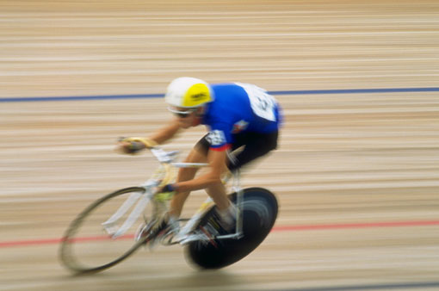
OSI Model Analogy : Application Layer - Destination
Your friend enjoys riding his new bicycle in UTM.

Slide 105
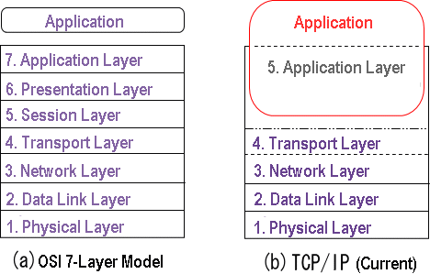
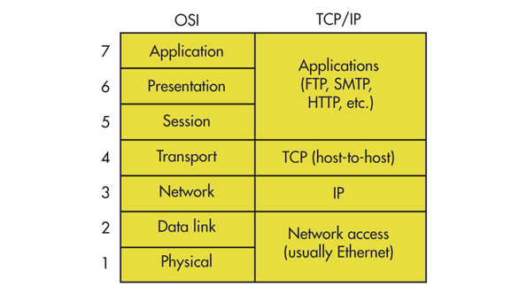
Internet protocol stack (TCP/IP)
TCP/IP was developed by Advanced Research Projects Agency (ARPA) to build a nationwide packet data network in 1960s. It was first used in UNIX-based computers in universities and government installations. Today, it is the main protocol used in all Internet operations.
Notes:
1960s – TCPIP
1970s – OSI

Slide 106
Internet protocol stack (TCP/IP)
application: supporting network applications
  IMAP, SMTP, HTTP
transport: process-process data transfer
  TCP, UDP
network: routing of datagrams from source to destination
  IP, routing protocols
link: data transfer between neighboring network elements
  Ethernet, 802.11 (WiFi), PPP
physical: bits “on the wire”
application
transport
network
link
physical

Slide 107
ISO/OSI reference model
presentation: allow applications to interpret meaning of data, e.g., encryption, compression, machine-specific conventions
session: synchronization, checkpointing, recovery of data exchange
Internet stack “missing” these layers!
  these services, if needed, must be implemented in application
  needed?
application
presentation
session
transport
network
link
physical

Slide 108
Encapsulation
source
message
M
application
transport
network
link
physical
segment
H_{t}
M
H_{t}
datagram
H_{n}
H_{n}
H_{t}
M
frame
H_{l}
H_{n}
H_{t}
M
link
physical
switch
destination
H_{n}
H_{t}
M
network
link
physical
M
application
transport
network
link
physical
H_{l}
H_{n}
H_{t}
M
H_{n}
H_{t}
M
H_{t}
M
H_{n}
H_{t}
M
H_{l}
H_{n}
H_{t}
M
router

Slide 109
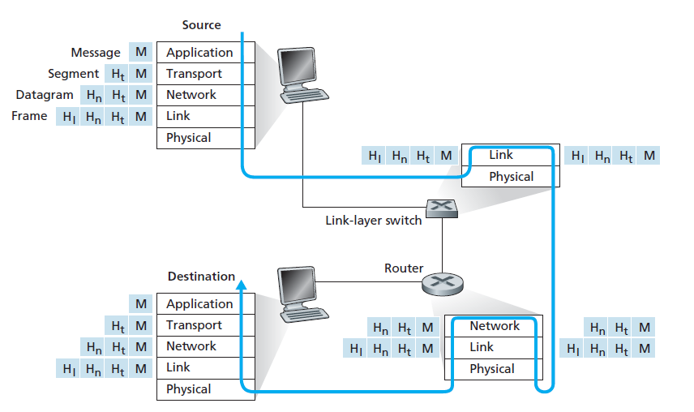
Encapsulation

Slide 110
Chapter 1: roadmap
What is the Internet?
What is a protocol?
Network edge: hosts, access network, physical media
Network core: packet/circuit switching, internet structure
Performance: loss, delay, throughput
Security
Protocol layers, service models
History
Notes:
Segue: from performanceto security

Slide 111
Network security
field of network security:
  how bad guys can attack computer networks
  how we can defend networks against attacks
  how to design architectures that are immune to attacks
Internet not originally designed with (much) security in mind
  original vision: “a group of mutually trusting users attached to a transparent network” ☺
  Internet protocol designers playing “catch-up”
  security considerations in all layers!

Slide 112
Bad guys: malware
malware can get in host from:
  virus: self-replicating infection by receiving/executing object (e.g., e-mail attachment)
  worm: self-replicating infection by passively receiving object that gets itself executed
spyware malware can record keystrokes, web sites visited, upload info to collection site
infected host can be enrolled in botnet, used for spam or distributed denial of service (DDoS) attacks

Slide 113
Bad guys: Malware
Malware = malicious software
  Examples: Worm, Virus, Trojans, spyware, botnet, etc.
Malware can be
  Self-replicating 🡺 once it infects one host, from that host it seeks entry into other hosts over the Internet, and just keep going
  User activated (click on an email attachment) or
  Program activated (a vulnerable app that activates malware)
  Recruiting your device to be part of a botnet, to be use for any purpose later

Slide 114

Bad guys: denial of service
Denial of Service (DoS): attackers make resources (server, bandwidth) unavailable to legitimate traffic by overwhelming resource with bogus traffic
1. select target
2. break into hosts around the network (see botnet)
3. send packets to target from compromised hosts
target

Slide 115
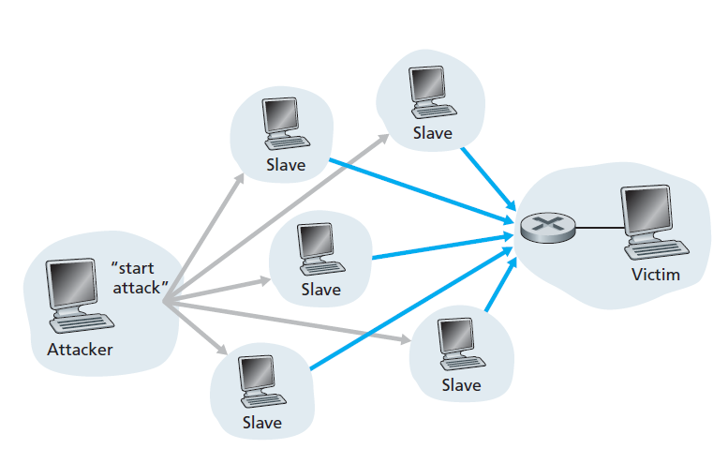
Denial of Service (DoS):

Slide 116

Bad guys: packet interception
packet “sniffing”:
  broadcast media (shared Ethernet, wireless)
  promiscuous network interface reads/records all packets (e.g., including passwords!) passing by
A
C
src:B dest:A payload
B
  Wireshark software used for our end-of-chapter labs is a (free) packet-sniffer

Slide 117
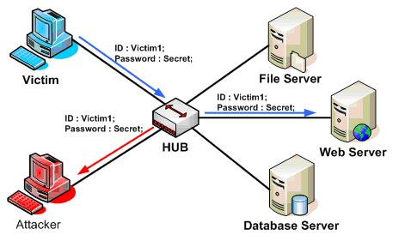
Packet “sniffing”:

Slide 118
Bad guys: fake identity
IP spoofing: send packet with false source address
A
C
src:B dest:A payload
B

Slide 119
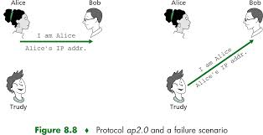
IP spoofing:

Slide 120
Chapter 1: roadmap
What is the Internet?
What is a protocol?
Network edge: hosts, access network, physical media
Network core: packet/circuit switching, internet structure
Performance: loss, delay, throughput
Security
Protocol layers, service models
History

Slide 121

Internet history
1961-1972: Early packet-switching principles
1961: Kleinrock - queueing theory shows effectiveness of packet-switching
1964: Baran - packet-switching in military nets
1967: ARPAnet conceived by Advanced Research Projects Agency
1969: first ARPAnet node operational
1972:
  ARPAnet public demo
  NCP (Network Control Protocol) first host-host protocol
  first e-mail program
  ARPAnet has 15 nodes

Slide 122
Internet history
1972-1980: Internetworking, new and proprietary nets
1970: ALOHAnet satellite network in Hawaii
1974: Cerf and Kahn - architecture for interconnecting networks
1976: Ethernet at Xerox PARC
late70’s: proprietary architectures: DECnet, SNA, XNA
late 70’s: switching fixed length packets (ATM precursor)
1979: ARPAnet has 200 nodes
Cerf and Kahn’s internetworking principles:
  minimalism, autonomy - no internal changes required to interconnect networks
  best-effort service model
  stateless routing
  decentralized control
define today’s Internet architecture

Slide 123
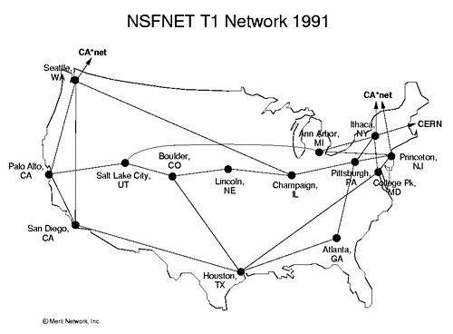
Internet history
1980-1990: new protocols, a proliferation of networks
1983: deployment of TCP/IP
1982: smtp e-mail protocol defined
1983: DNS defined for name-to-IP-address translation
1985: ftp protocol defined
1988: TCP congestion control
new national networks: CSnet, BITnet, NSFnet, Minitel
100,000 hosts connected to confederation of networks

Slide 124
Internet history
1990, 2000s: commercialization, the Web, new applications
early 1990s: ARPAnet decommissioned
1991: NSF lifts restrictions on commercial use of NSFnet (decommissioned, 1995)
early 1990s: Web
  hypertext [Bush 1945, Nelson 1960’s]
  HTML, HTTP: Berners-Lee
  1994: Mosaic, later Netscape
  late 1990s: commercialization of the Web
late 1990s – 2000s:
more killer apps: instant messaging, P2P file sharing
network security to forefront
est. 50 million host, 100 million+ users
backbone links running at Gbps

Slide 125
Internet history
2005-present: more new applications, Internet is “everywhere”
~18B devices attached to Internet (2017)
    rise of smartphones (iPhone: 2007)
aggressive deployment of broadband access
increasing ubiquity of high-speed wireless access: 4G/5G, WiFi
emergence of online social networks:
    Facebook: ~ 2.5 billion users
service providers (Google, FB, Microsoft) create their own networks
    bypass commercial Internet to connect “close” to end user, providing “instantaneous” access to search, video content, …
enterprises run their services in “cloud” (e.g., Amazon Web Services, Microsoft Azure)

Slide 126
Chapter 1: summary
We’ve covered a “ton” of material!
Internet overview
what’s a protocol?
network edge, access network, core
  packet-switching versus circuit-switching
  Internet structure
performance: loss, delay, throughput
layering, service models
security
history
You now have:
context, overview, vocabulary, “feel” of networking
more depth, detail, and fun to follow!

Slide 127
Additional Chapter 1 slides

Slide 128

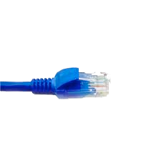
Wireshark
application
(www browser,
email client)
packet
analyzer
application
OS
packet
capture
(pcap)
Transport (TCP/UDP)
Network (IP)
Link (Ethernet)
Physical
copy of all Ethernet frames sent/received

